Slide 1
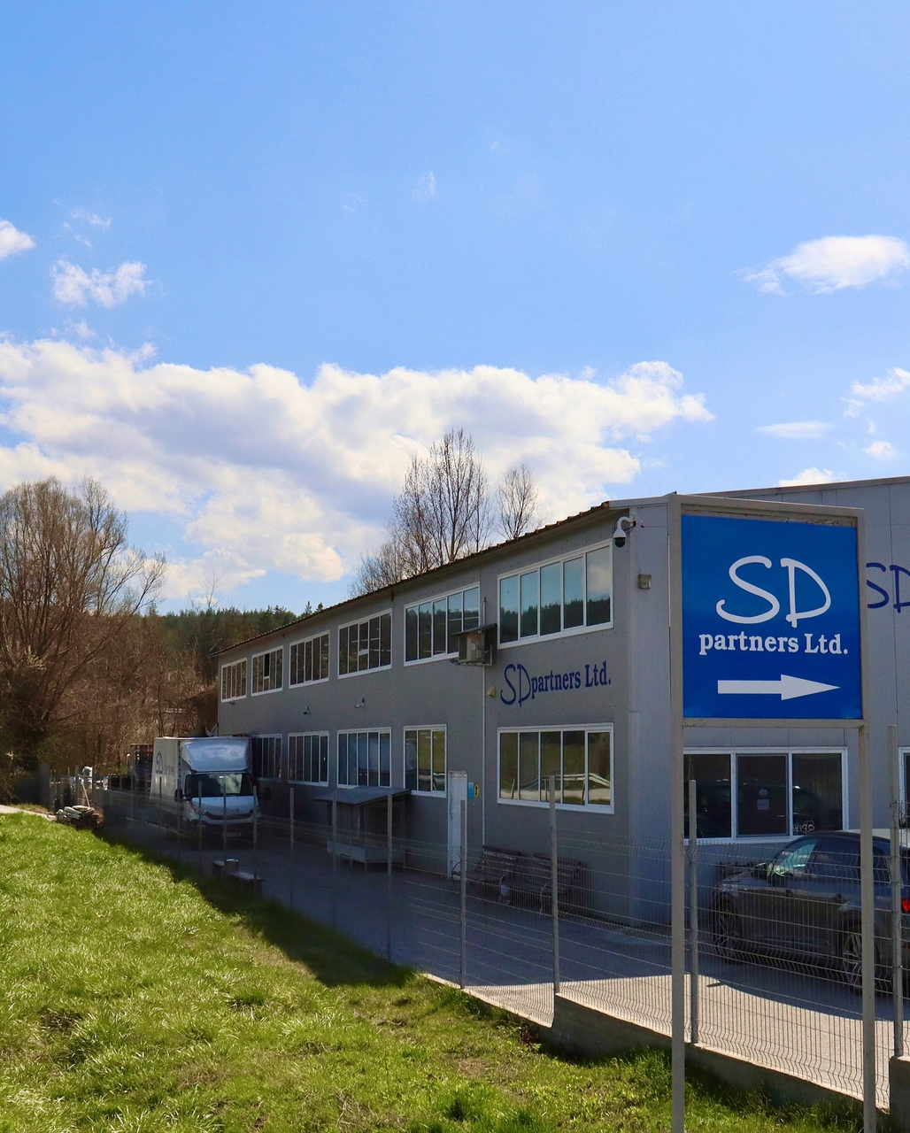
SD Partners Ltd.
SOLUTION DELIVERY
sdpartners.bg
Notes:
© Copyright PresentationGO.com – The free PowerPoint and Google Slides template library

Slide 2
About the company
SD Partners Ltd. was founded in 2006 by Dipl. Eng. Hristo Dradalov who has more than 30 years of experience in the field of mechanical engineering. ​He was the sole owner and manager of the company until 2024, when the rest of the family - Vesela Dradalova, Dipl. Eng. Iva Dradalova, and Nia Dradalova joined as partners.
We are quick developing company with customers from whole Europe. We are investing in new machines and technologies.
SD Partners Ltd. sdpartners.bg
Notes:
© Copyright PresentationGO.com – The free PowerPoint and Google Slides template library

Slide 3
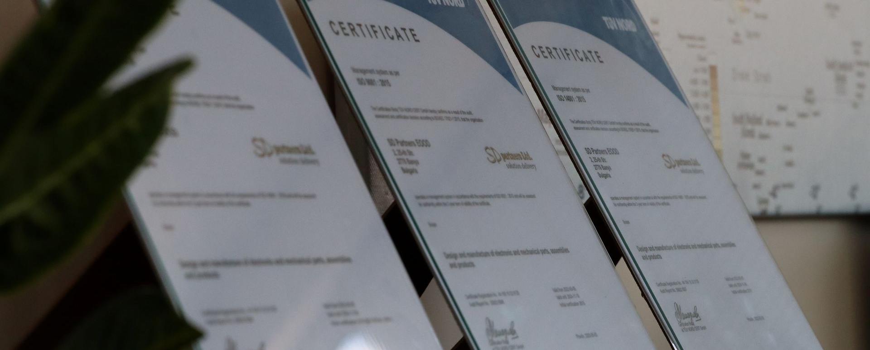
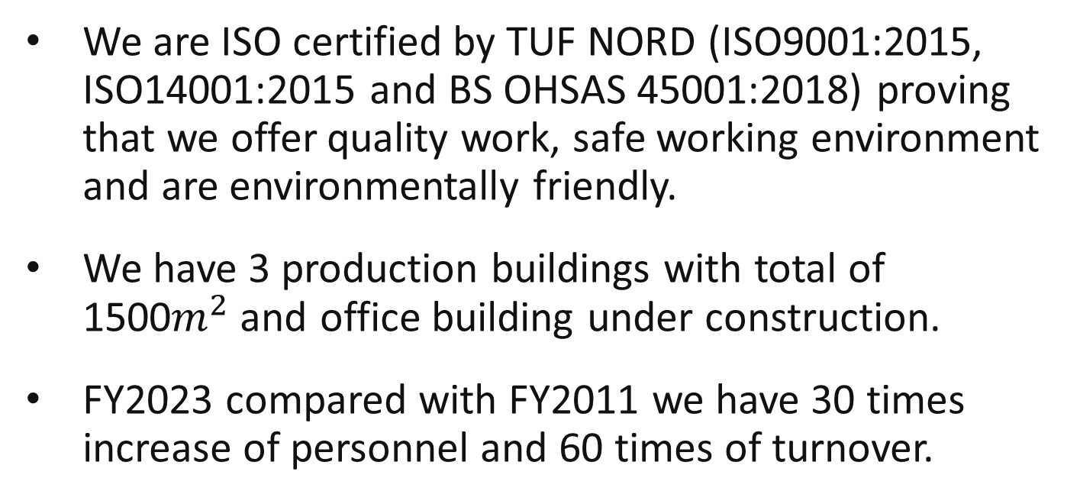
We are ISO certified by TUF NORD (ISO9001:2015, ISO14001:2015 and BS OHSAS 45001:2018) proving that we offer quality work, safe working environment and are environmentally friendly.
We have 3 production buildings with total of 1500$m^{2}$and office building under construction.
FY2023 compared with FY2011 we have 30 times increase of personnel and 60 times of turnover.
SD Partners Ltd. sdpartners.bg
Notes:
© Copyright PresentationGO.com – The free PowerPoint and Google Slides template library

Slide 4
Scope of work
Design and manufacturing of tools, jigs, whole working places, fixtures, equipment and non-standard parts.
3D CAD/CAM, CNC machining – mill, lathe, EDM and wire EDM- small to middle size series and unique parts.
We offer assembly automation solutions and PLC programing.
Mechanical assemblies, Spot weldings, Solderings – manual, semi-automatic, with or without special fixtures and machines – wide range of products in large series based on customer specifications.
Mechanical parts – stamping, injection molding, threading, bending, punching and other.
Technological support for own production.
Repairs.
SD Partners Ltd. sdpartners.bg
Notes:
© Copyright PresentationGO.com – The free PowerPoint and Google Slides template library

Slide 5
Machinery
CNC vertical machining center HAAS VF1
CNC vertical machining center HAAS VF1yt
CNC vertical machining center HAAS VF3
CNC vertical machining center HAAS VF2
CNC vertical machining center HAAS VF2SSYT
CNC vertical machining center HAAS Mini Mill
Machining center MICRON
CNC lathe HAAS ST10
CNC lathe HAAS ST15
SD Partners Ltd. sdpartners.bg
Notes:
© Copyright PresentationGO.com – The free PowerPoint and Google Slides template library

Slide 6
Machinery
Wire EDM machine ( AGIECharmilles Cut 20P -300x400)
EDM sinking machines CHARMILLES
2 Presses 20t
1 Press 50t
3 Injection molding machines - ARBURG 270S 250-60; 270C 500-100 and 270C golden edition
Thread cutting machines
Drilling machines
Grinding machines
Other
SD Partners Ltd. sdpartners.bg
Notes:
© Copyright PresentationGO.com – The free PowerPoint and Google Slides template library

Slide 7
Human resources
Long-term strategy for management of human recourses.
Investing in staff training and foreign language skills.
Paying special attention to customer-supplier relationship.
Supporting and motivating our team is utmost priority.
130+ people working in the company
8 graduated engineers
SD Partners Ltd. sdpartners.bg

Slide 8
Trainee system
Effective inhouse training system, that relays on the knowledge of our experts and engineers.
We give opportunities to students, by employing them hourly and on the weekends. In this way they can learn the know-how parallel to studying.
Currently 2 engineering students employed.
Employing young staff members based on their potential, intelligence and technical skills.
SD Partners Ltd. sdpartners.bg

Slide 9
Our Advantages
We are highly motivated team, eager to meat new challenges.
We are determined to grow along our partners by providing good communication and experience and skill.
Quality is a main goal in our work.
We offer flexibility and competitive prices.
SD Partners Ltd. sdpartners.bg

Slide 10
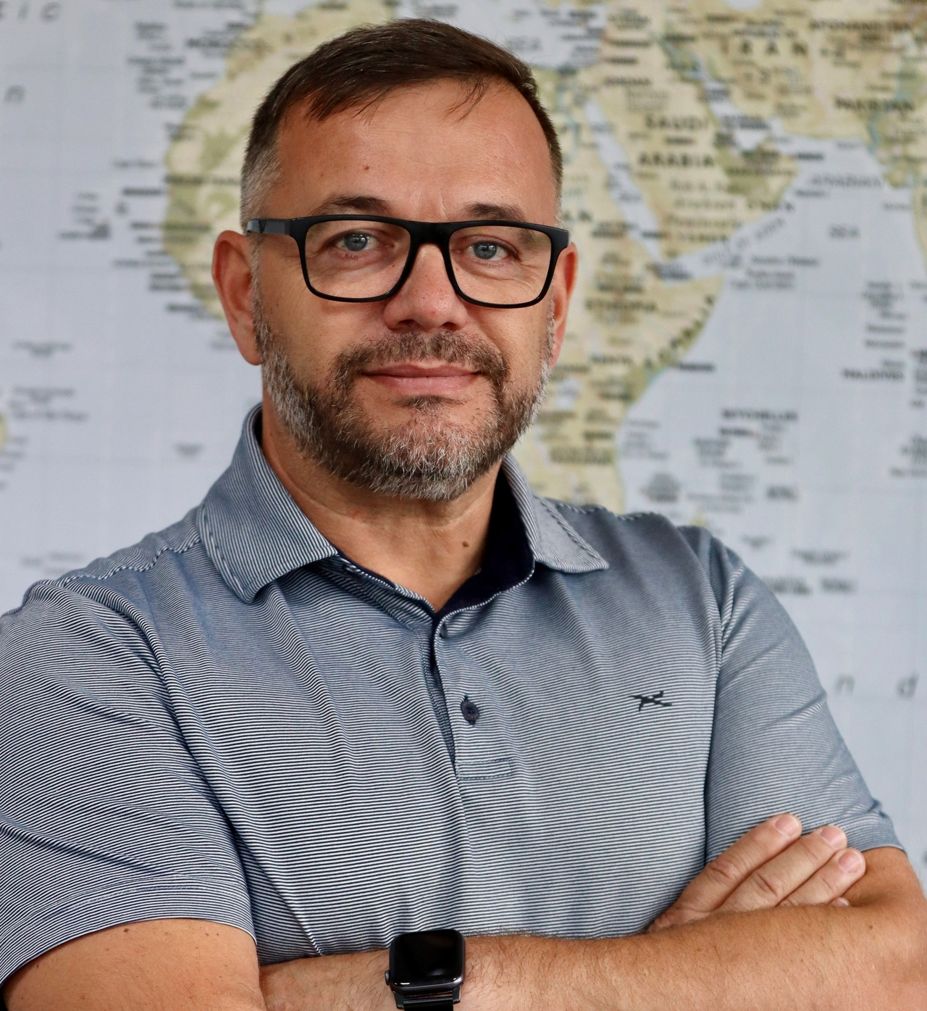
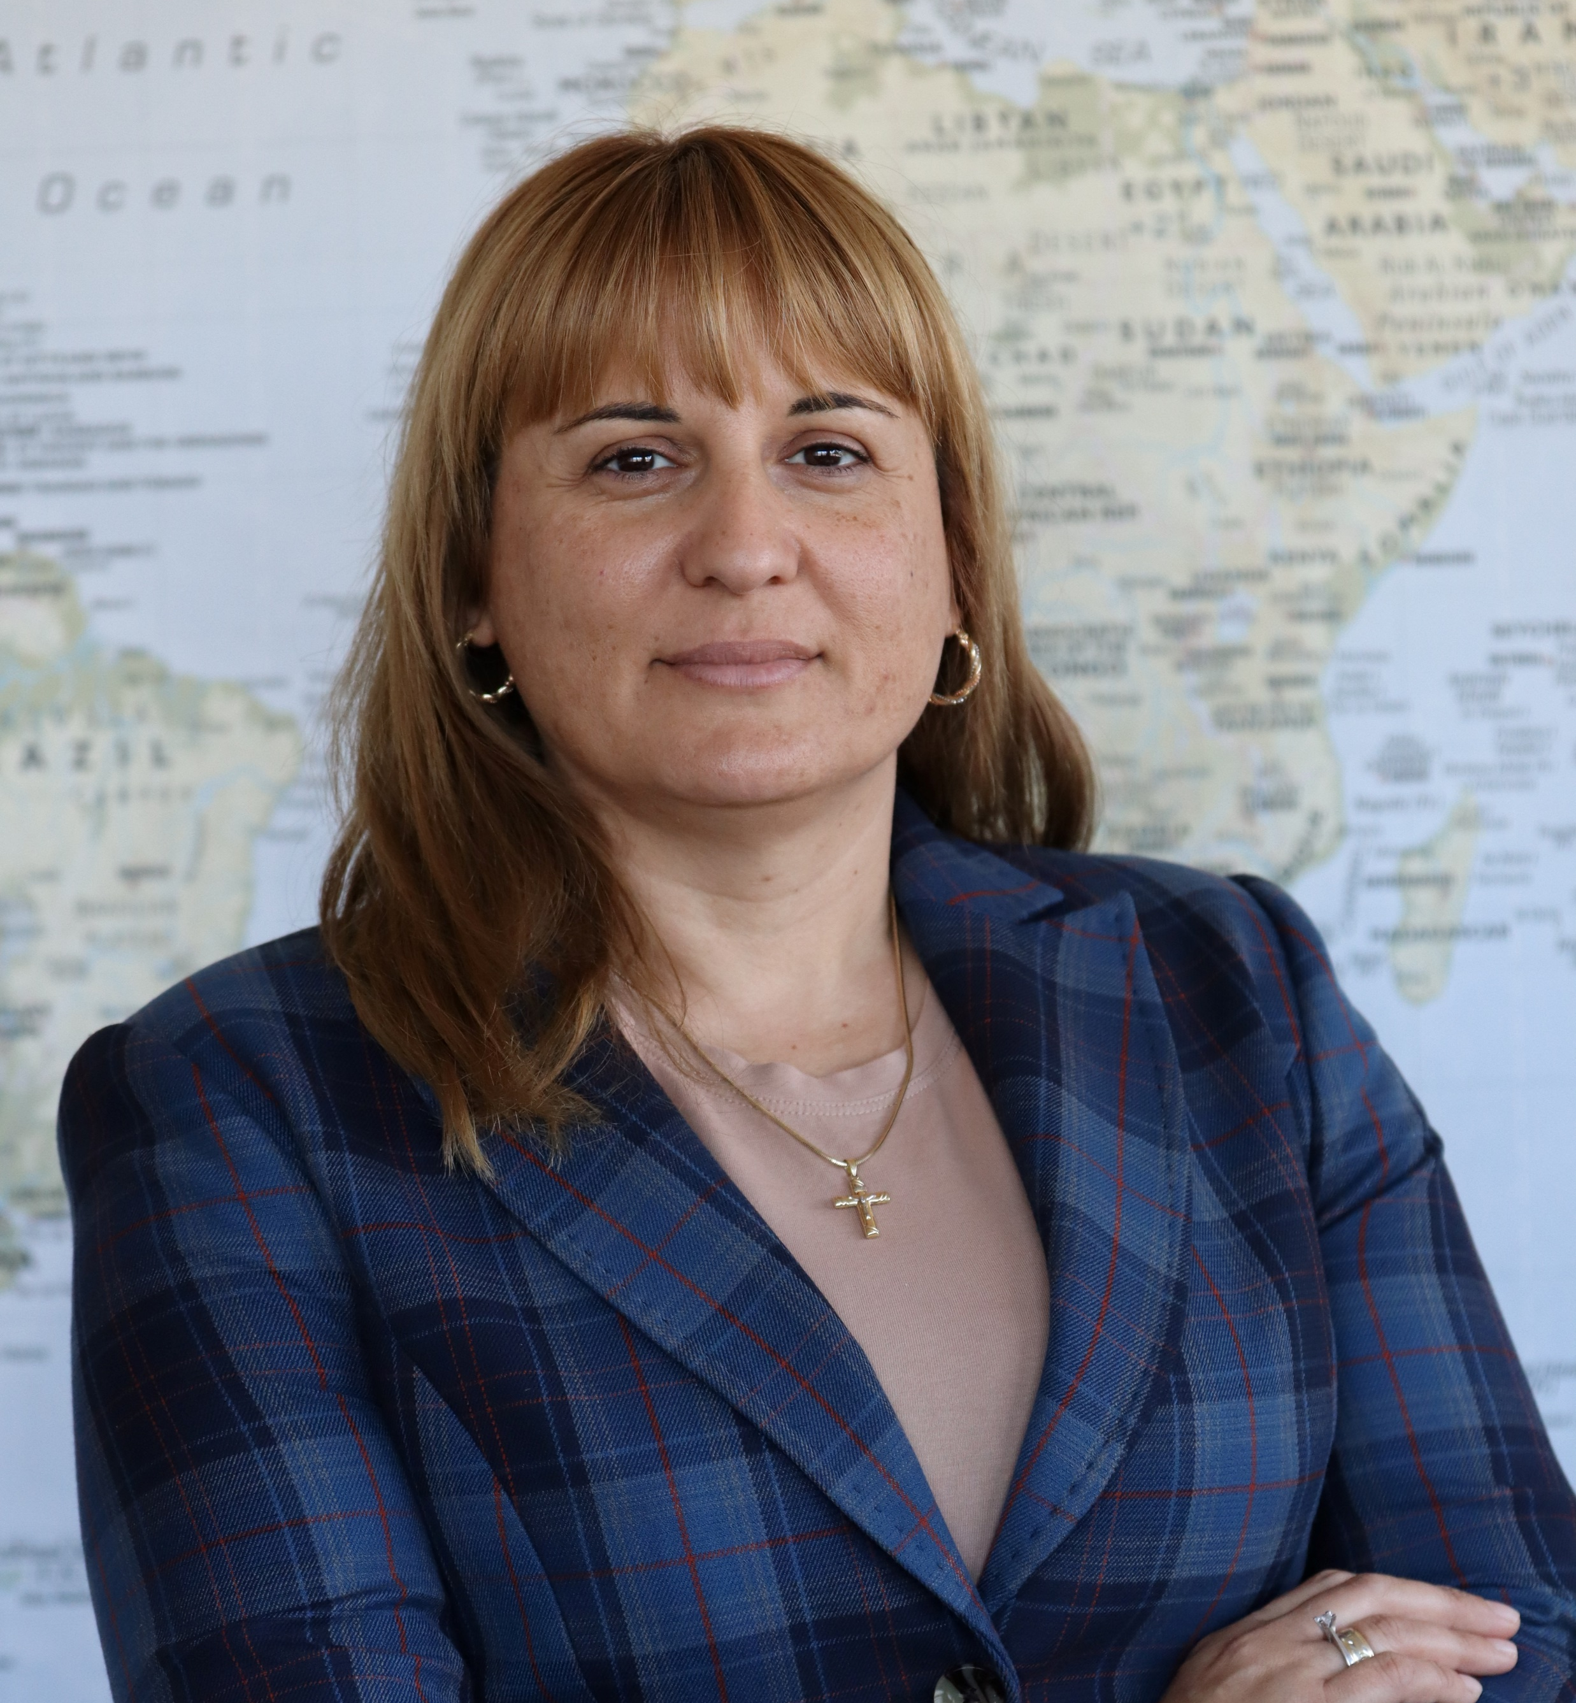
Our senior management team of experts
Dipl. Eng.
Hristo Dradalov
Vesela Dradalova
Co-owner and CEO
Co-owner and CEO
dradalov@sdpartners.bg
dradalova@sdpartners.bg
SD Partners Ltd. sdpartners.bg

Slide 11
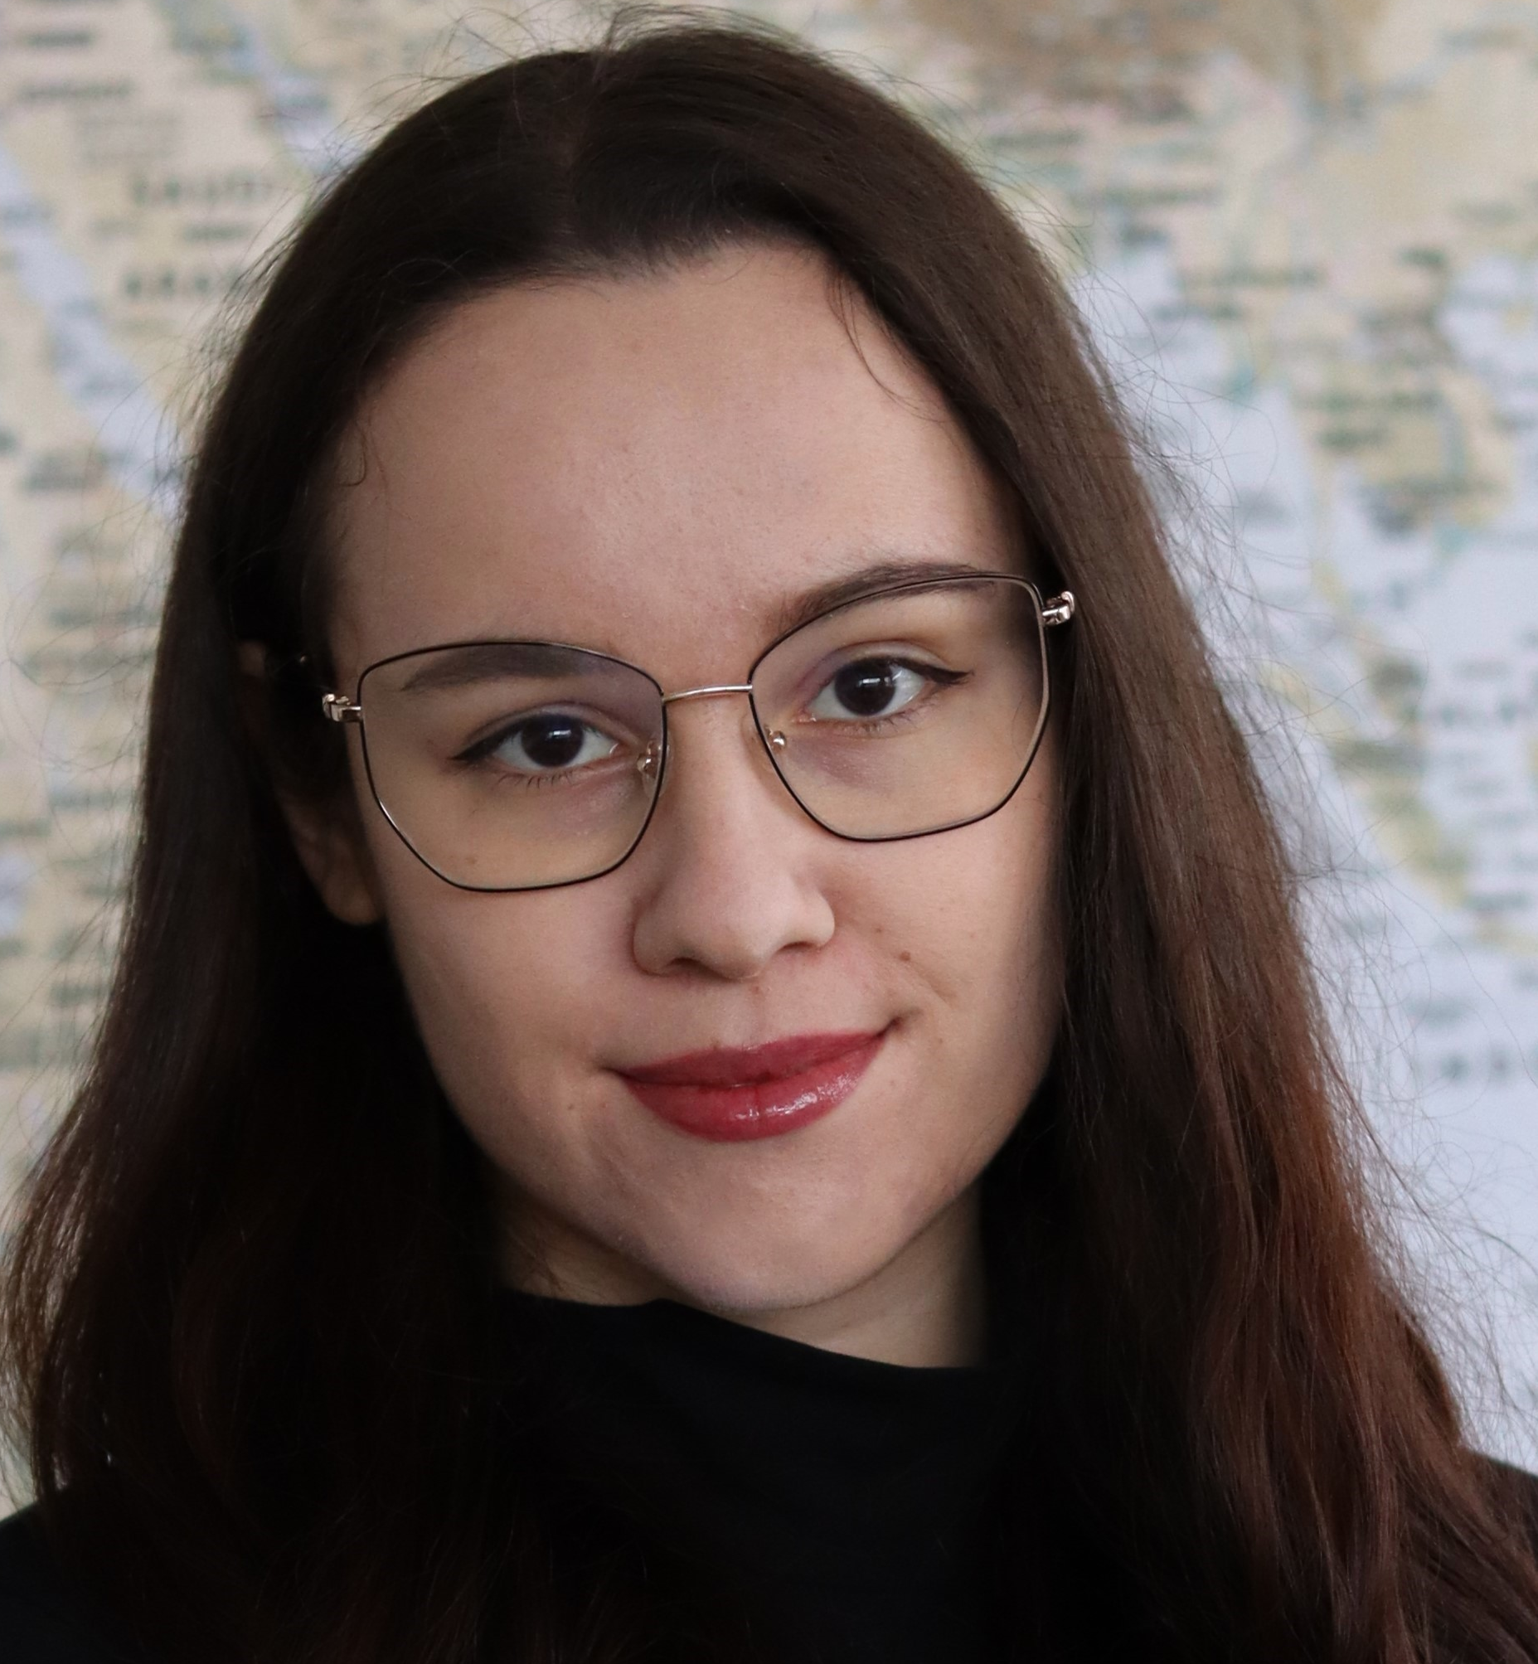
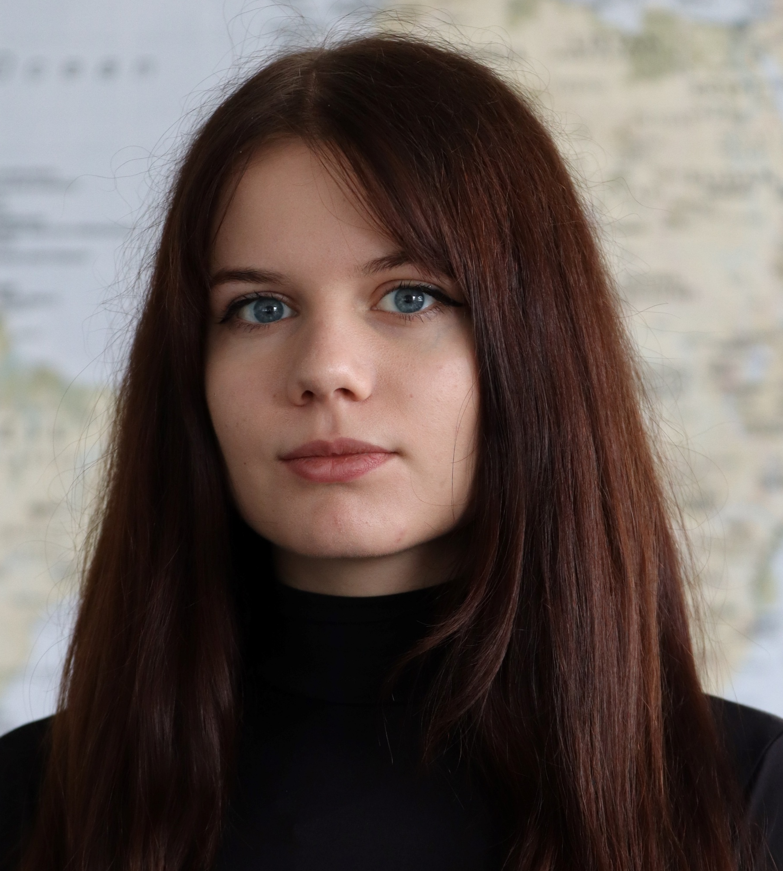
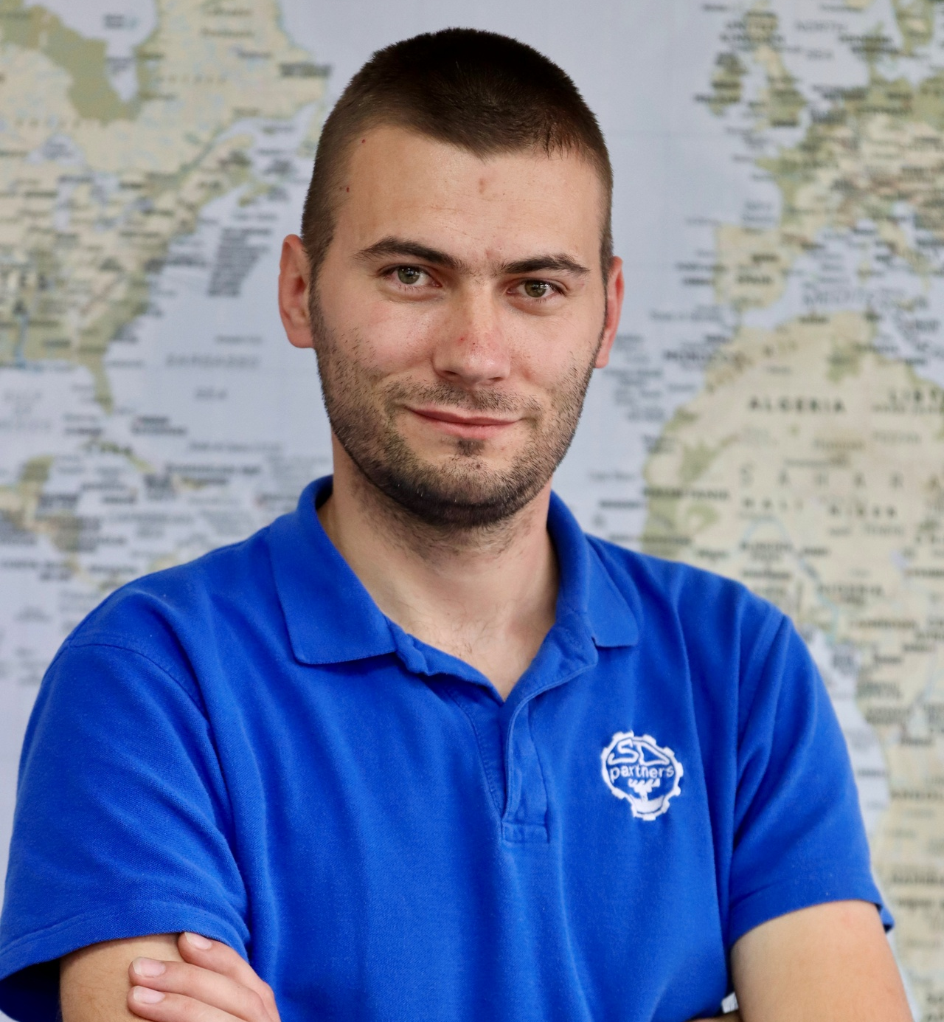
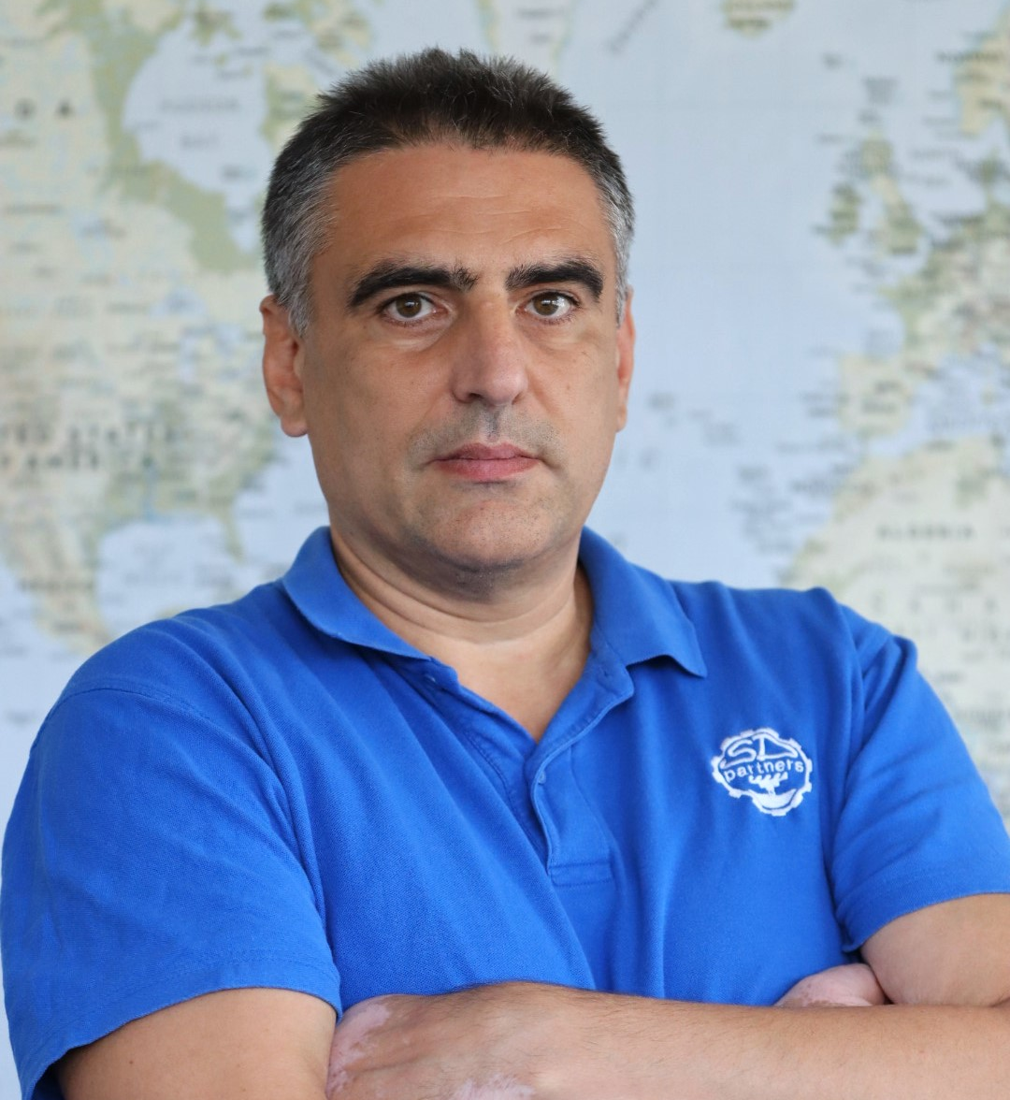
Our managing team of experts
Dipl. Eng.
Iva Dradalova,
EMBA
Nia Dradalova
Co-owner and production manager
Co-owner and production manager
ivadradalova@sdpartners.bg
niadradalova@sdpartners.bg
Eng.
Hristo Stefanov
Dipl. Eng.
Stoycho Belchev
Chief Engineer
Chief Designer
stefanov@sdpartners.bg
belchev@sdpartners.bg
SD Partners Ltd. sdpartners.bg

Slide 12

Thank You!
Learn more about us and what we do on our website sdpartners.bg
We are a highly motivated team willing to meet new challenges!
SD Partners Ltd.
+359 887 89 20 78
office@sdpartners.bg
Notes:
© Copyright PresentationGO.com – The free PowerPoint and Google Slides template library

